Slide 1
Navigating the
Health Care System:
An Adolescent Health
Literacy Curriculum
https://www.movinghealthcareupstream.org/navigating-the-health-care-system/

Slide 2
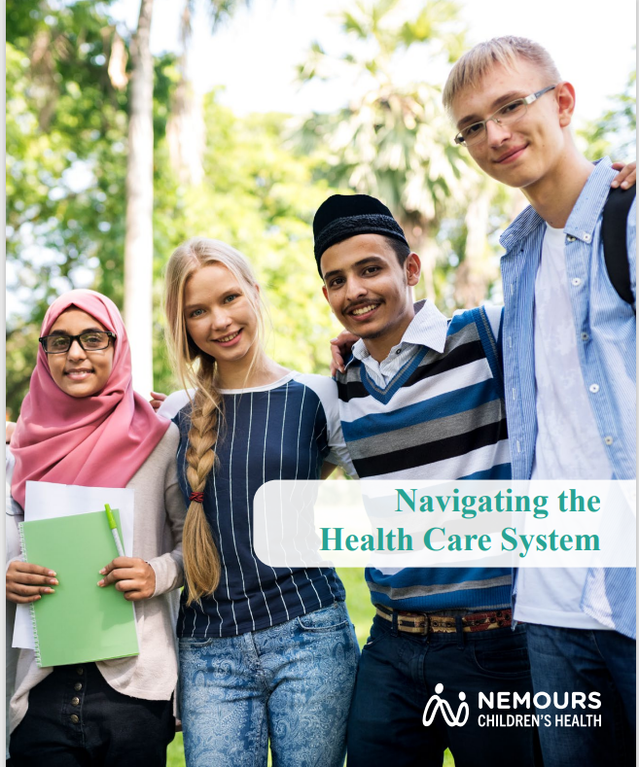
Navigating the Health Care System
A four-module health literacy curriculum designed by Nemours Children’s Health for use with young adults.
Designed to prepare high school and college-age teens to be responsible for managing their own health care as they transition into adulthood.
Materials are suitable for in-class, in-home, after-school, and community settings, and can be taught virtually.

Slide 3
Navigating the Health Care System
Inspired by the curriculum’s strong evaluation outcomes, in Spring 2018 Nemours began making the curriculum available at no cost, nation-wide.
As of September 2021, the NTHCS user community includes 725+ registered users, representing 53 US states and territories.

Slide 4
Why Health Literacy?
The American Academy of Pediatrics, American College of Physicians, and American Academy of Family Physicians recognize that all adolescents require guidance, education and planning to manage their own health care as they become adults.¹
Health literacy is an important life skill. As health literacy increases, people are more likely to seek preventive services and enter the health system healthier, have lower rates of preventable hospital and emergency department visits, and are less likely to report their health as poor.²
¹ American Academy of Pediatrics; American Academy of Family Physicians; American College of Physicians; Transitions Clinical Report Authoring Group, Cooley WC, Sagerman PJ. Supporting the health care transition from adolescence to adulthood in the medical home. Pediatrics. 2011;128(1):182-200.
² https://health.gov/communication/literacy/quickguide/factsliteracy.htm

Slide 5
Defining Health Literacy within NTHCS
For the purpose of NTHCS, health literacy is defined as:
Knowing what to expect as you move through the health care system and as you interact with health care professionals
Having the skills to successfully navigate the health care system, including:
  Skills for communicating effectively with care providers
  Skills for self-advocacy

Slide 6
Contents
Introduction (slides 1-5)
Nemours Children’s Health & NTHCS Context (slides 7-10)
The Highlights of Using NTHCS (slide 11)
Background (slides 12-13)
Evaluation (slides 14-20)
Topics & Materials (slides 21-25)
Overview of the 4 Modules (slides 26-39)
Alignment with State & National Standards (slides 40-43)
For More Information / Contact Information (slide 44)

Slide 7

Nemours is a nonprofit pediatric health system dedicated to:
life-changing medical care and research.
training tomorrow’s pediatric experts.
helping kids grow up healthy.
advocating for kids nationally.
Where we offer care:
Delaware
Florida
Georgia
New Jersey
Pennsylvania

Slide 8

Navigating the Health Care System is one of many Healthy Living & Learning resources Nemours offers for those working with children and teens.

Slide 9
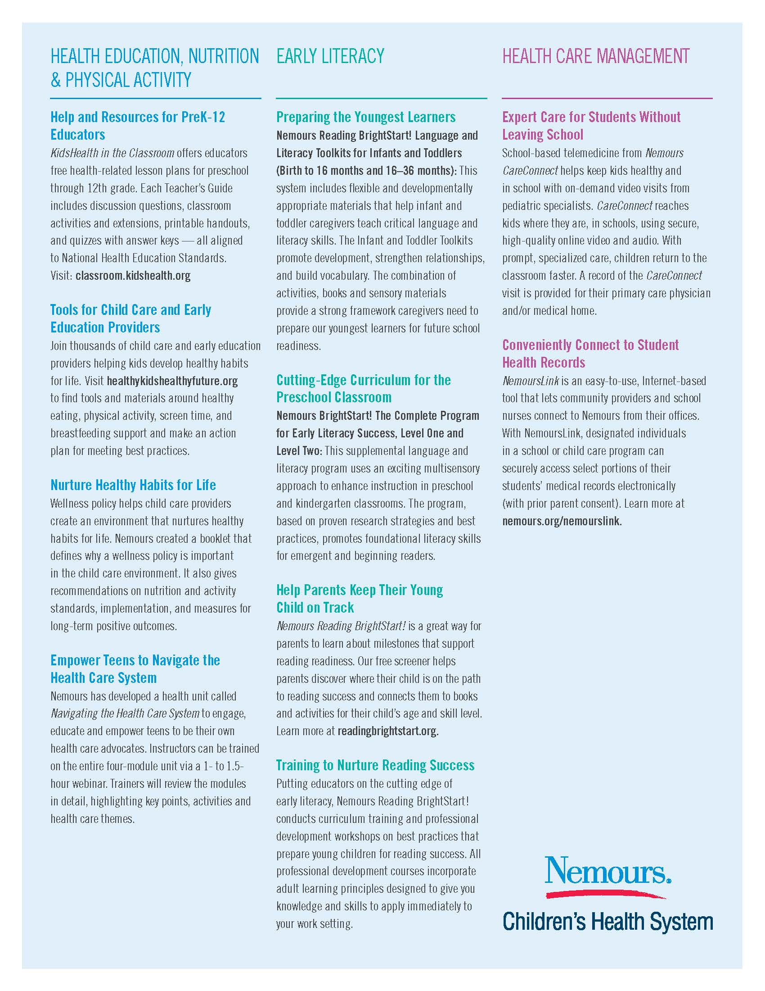


Slide 10

Monthly Newsletter
www.classroom.kidshealth.org/

Slide 11
NTHCS Highlights
Available from Nemours at no cost
Strong evaluation outcomes from a statistically meaningful sample size
Aligned with National Health Education Standards
Pre/post tests available, but not required
Facilitator’s Guide for DIY training + scripted presentation slides
Technical assistance available for questions
Student workbooks available in PDF format
All materials are available online, via download

Slide 12
Background
Social workers at Nemours created an early version of this curriculum for use with patients with chronic health conditions, to prepare them to manage their own care as they became teens and aged out of pediatric care.
Recognizing that health literacy is a life skill needed by ALL teens and adults, not just those with chronic health conditions, Nemours Health & Prevention Services began to create a version of the curriculum that could be used with teens in school and community settings.

Slide 13
Background
The curriculum was designed to address national and state education standards (Delaware). Nemours employees began piloting the course in 2014 in collaboration with schools and other community sites in Delaware. Feedback from participants, presenters, and parents was used to refine the content.
Response to the lessons from students, teachers and parents has been consistently positive and evaluation outcomes have been strong.

Slide 14
Evaluation Results (DE)
Pre/post test differences: Overall, post-test knowledge scores were significantly higher than pre-test scores
2014/2015 Results
Pre-test |  |  |  | Post-test
 | Mean (SD) | % correct | N | Mean (SD) | % correct | N | Significance
Overall | 10.88 (2.38) | 64% | 986 | 13.99 (2.74) | 82% | 948 | 0.000
2015/2016 Results
Pre-test |  |  |  | Post-test
 | Mean (SD) | % correct | N | Mean (SD) | % correct | N | Significance
Overall | 10.82 (2.34) | 63.6% | 949 | 13.64 (2.99) | 80.2% | 928 | 0.000
2016/2017 Results
Pre-test |  |  |  | Post-test
 | Mean (SD) | % correct | N | Mean (SD) | % correct | N | Significance
Overall | 10.63 (2.81) | 62.5% | 922 | 13.60 (3.27) | 80.0% | 897 | 0.000

Slide 15
Evaluation Results (DE)
  Significantly higher post test scores regardless of teacher type (health, physical education, school nurse and health services/technical education)
Data in cells for Mean (SD); % correct, N, and Significance: Top number 2014/2015 school year, Bottom number 2015/2016 school year
 | Pre-test |  |  | Post-test |  |  | Significance
Teacher Type | Mean (SD) | % correct | N | Mean (SD) | % correct | N
Health Teacher | 10.62 (2.39) 10.71 (2.37) | 62% 63% | 605 752 | 13.60 (2.97) 13.74 (2.94 | 80% 81% | 581 746 | 0.000 0.000
Health Sciences/Career Technical Ed Teacher | 12.11 (2.12) 11.30 (2.08) | 71% 67% | 179 169 | 14.98 (2.02) 13.22 (3.08) | 88% 78% | 180 158 | 0.000 0.000
School Nurse | 10.36 (2.10) 11.03 (2.75) | 61% 65% | 158 28 | 14.44 (2.05) 13.95 (3.65) | 85% 82% | 147 24 | 0.000 0.002
Physical Education Teacher | 11.32 (2.23) | 67% | 161 | 14.53 (2.73) | 85% | 152 | 0.000

Slide 16
Evaluation Results (DE)
(Neutral responses not shown. Data does not add to 100%.)

Slide 17
Evaluation Results (DE)

Slide 18
Evaluation Results (DE)

Slide 19
Evaluation & National Expansion
National expansion began informally in the 2016/2017 academic year.
Organizations in three states (Wisconsin, Illinois and Texas) used the lesson plans and submitted pre/post data.
Participants’ scores rose from an average pre-course score of 65 percent correct to an average score of 81 percent post-course score- an average improvement of 16 percentage points.

Slide 20
Evaluation & National Expansion
2016-17 Results (WI, IL, TX)
 | Pre-Test |  |  | Post-Test
Site | Mean (SD) | % correct | N | Mean (SD) | % correct | N | Significance
1 | 12.90 (2.61) | 75.80% | 222 | 14.46 (2.59) | 85.10% | 275 | 0
2 | 11.73 (2.00) | 69.00% | 63 | 13.98 (2.27) | 82.20% | 60 | 0
3 | 10.83 (3.06) | 63.70% | 12 | 14.20 (1.39) | 83.50% | 10 | 0.004
4 | 11.50 (2.77) | 67.60% | 8 | 15.57 (1.13) | 91.50% | 7 | 0.004
5 | 10.42 (2.11) | 61.20% | 89 | 12.92 (2.64) | 76.00% | 88 | 0
6 | 9.75 (1.23) | 57.30% | 16 | 13.35 (2.46) | 78.70% | 14 | 0
7 | 10.25 (2.4) | 60.20% | 92 | 13.38 (2.97) | 78.70% | 78 | 0
8 | 12.72 (.90) | 74.80% | 11 | 14.90 (1.04) | 87.60% | 11 | 0
9 | 10.6 (2.84) | 62.30% | 60 | 12.55 (3.32) | 73.80% | 59 | 0.001
10 | 9.87 (2.11) | 58.10% | 79 | 12.75 (2.31) | 75.00% | 76 | 0

Slide 21
Topics Covered
The curriculum includes 4 modules:
Definitions (health, health care, self-advocacy, health literacy), types of care (emergency department, urgent care, primary care provider), self-advocacy, and personal/family medical history
Symptoms, diagnosis, medications and vaccinations
Health insurance and adolescents’ right to privacy
Practical application of the skills covered through real-life scenarios and role-plays

Slide 22
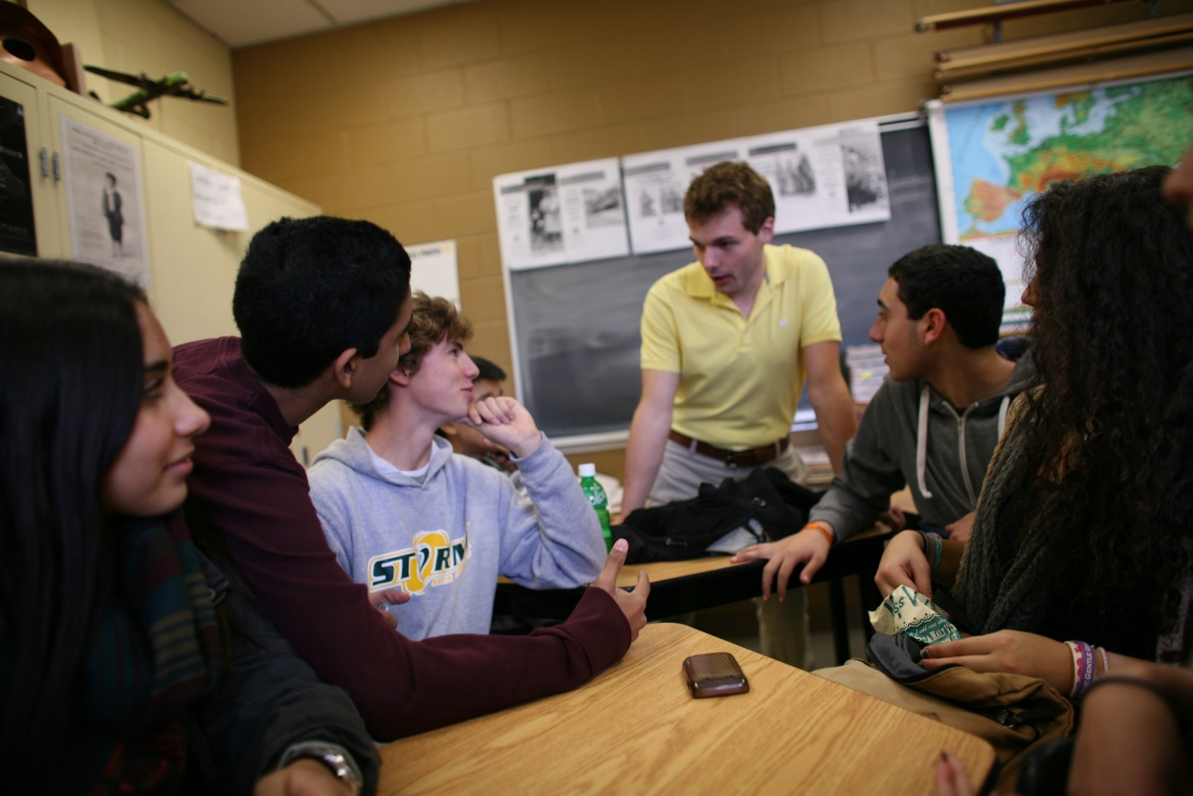
Structure
Not necessary to present each module from start to finish
Activities can be selected & presented a la carte

Slide 23

Materials
Information, brochure, sample workbook pages, and full suite of materials all available at:
  https://www.movinghealthcareupstream.org/navigating-the-health-care-system/
One-hour adult version added to website in Spring 2020

Slide 24
Materials https://www.movinghealthcareupstream.org/navigating-the-health-care-system-zip-files/
DIY Training Materials for Presenters
  Facilitator’s Guide- includes screen shots, sample scripts, links to materials needed for activities. (Nemours available for consultation: NTHCS@Nemours.org)
Presentation Materials- Organized by Module
  Scripted PPT Slide Deck for Each Module
  Participant Workbook- fillable PDF + electronic version of each activity
  Materials / Answer Keys for interactive Activities- options for in person and virtual
Evaluation Materials
  Pre/Post student knowledge survey and quiz (optional)

Slide 25
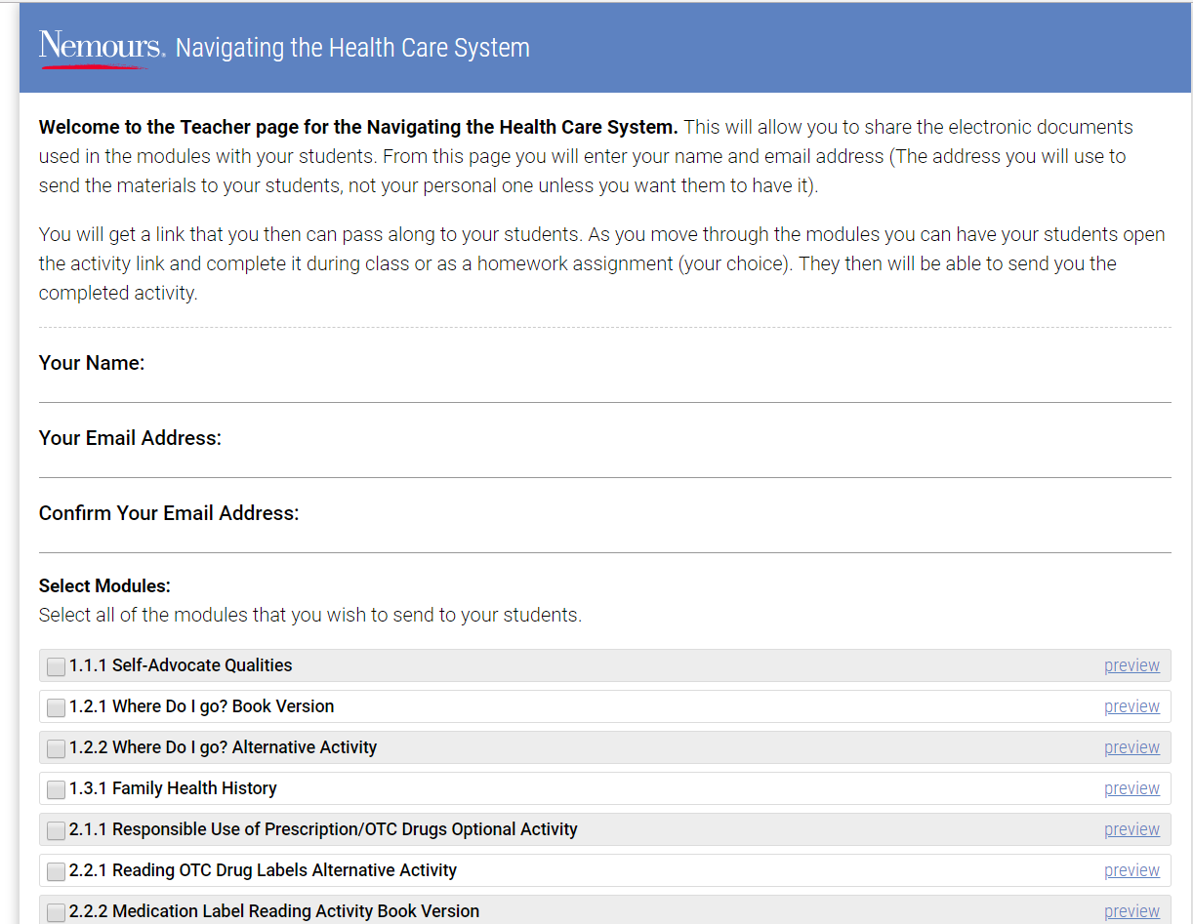
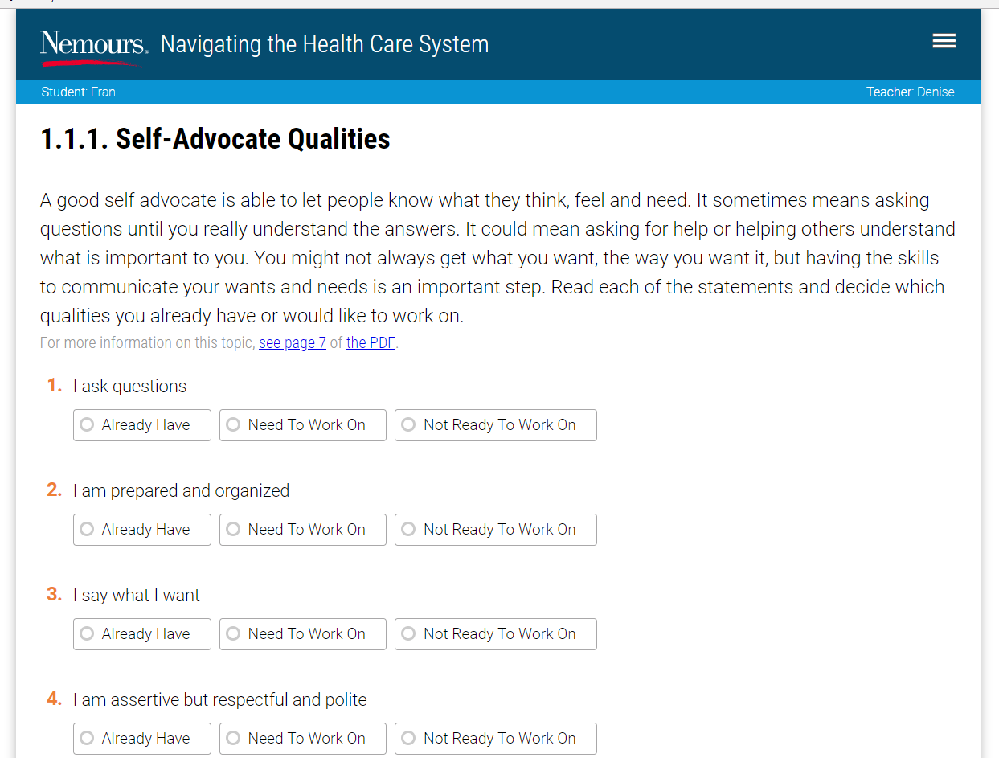
Materials (continued)
Sample screens from “electronic workbook”- to assign, complete and return activities:

Slide 26

Module 1

Slide 27
Module 1
Introduction of unit vocab (health, health care, health literacy, self advocacy)
Identify different types of doctors
Determine where to go for appropriate care
Examine Family Health History

Slide 28
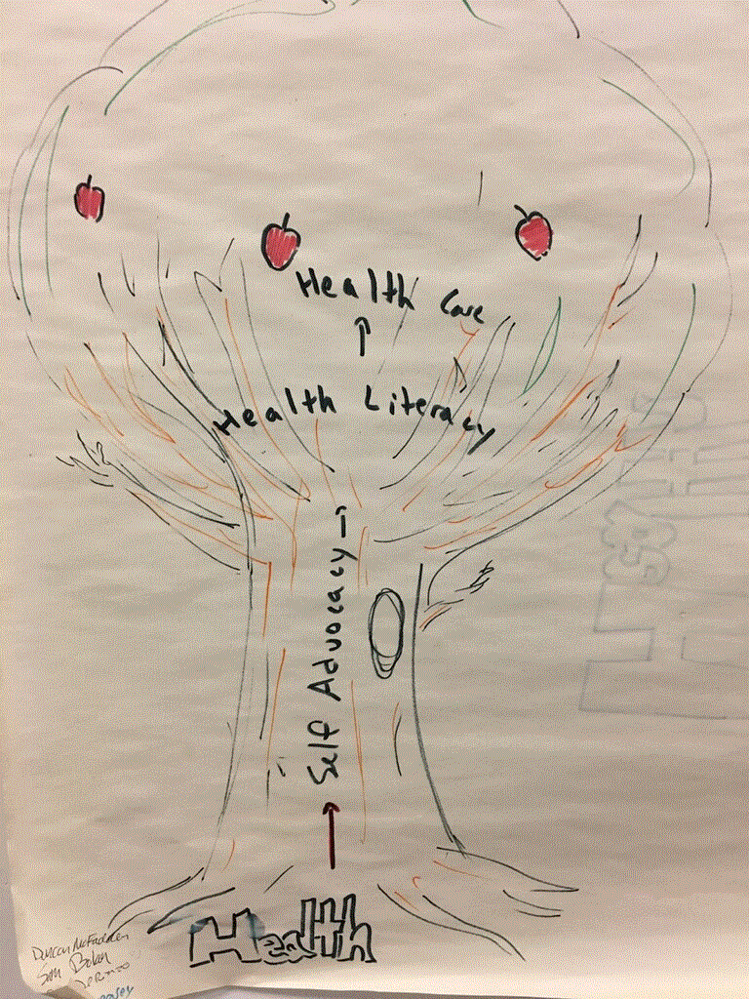
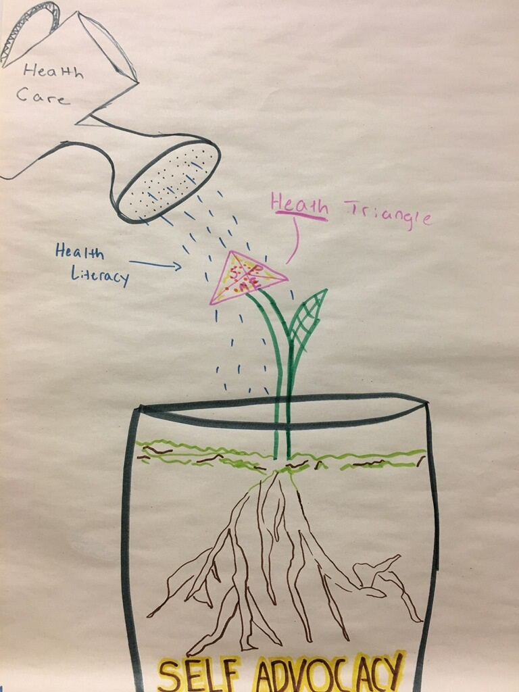
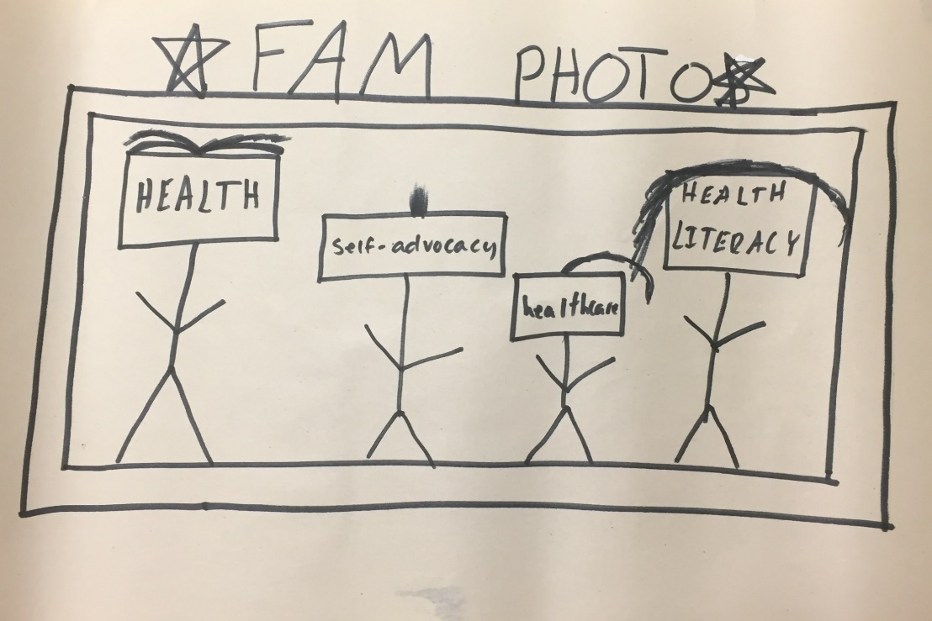
Module 1
Concept Maps

Slide 29
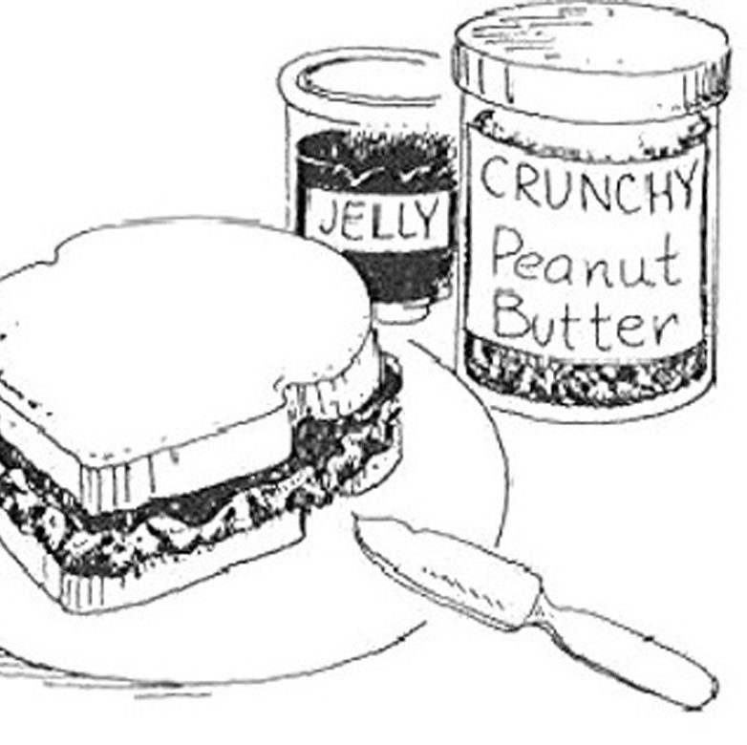
Module 1
Does everyone make their PB&J the same way?
How would someone know how to make your PB&J?
How does this activity relate to self-advocacy and communication?

Slide 30
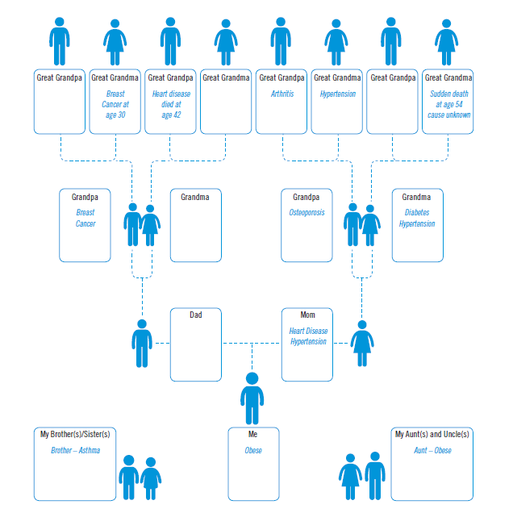
Module 1
Family Health History Analysis & Interview
Small group discussion & class discussion

Slide 31

Module 2

Slide 32
Module 2
Identify symptoms, diagnoses, and allergies
Define basic types of medications
Read/interpret a medicine label
Identify vaccinations

Slide 33
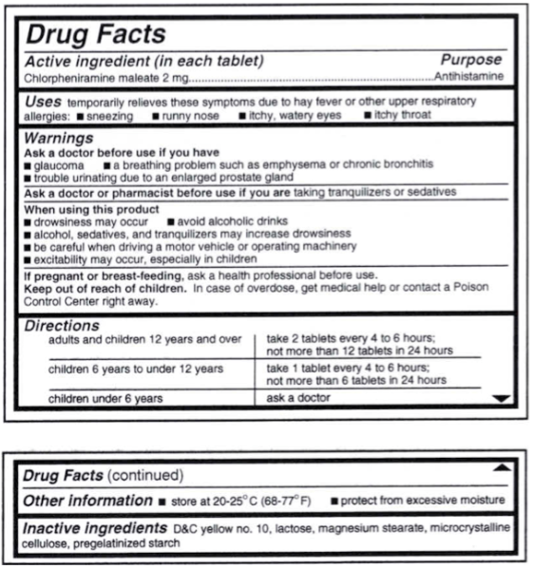
Module 2
“Reading OTC Labels” Activity
Small group & whole class discussion

Slide 34

Module 2
“Reading OTC Labels” Activity
Small group & whole class discussion

Slide 35

Module 3

Slide 36
Module 3
What types of insurance exist? How do I get insurance? How do I read an insurance card?
“Reading Insurance Cards” Activity
Privacy/Confidentiality
Small group & whole class discussion

Slide 37
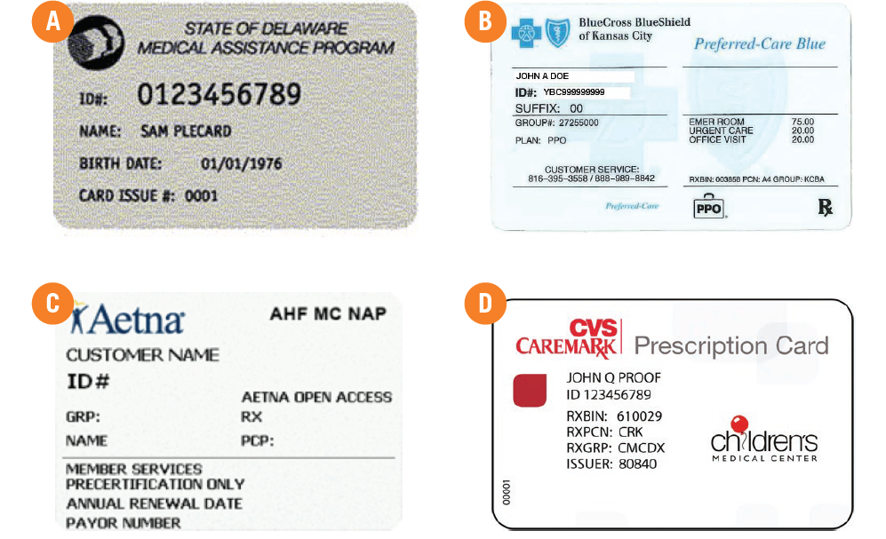
Module 3

Slide 38
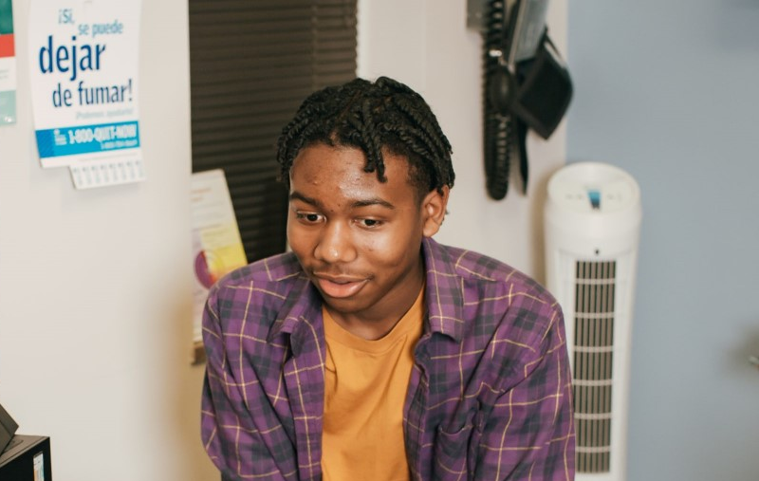
Module 4

Slide 39
Module 4
Identify important information to share when making an appointment
How to schedule an appointment
Completing medical forms
Small group & whole class discussion

Slide 40
Content Addresses Common Core State
& National Health Education Standards
Common Core State Standards
CCSS. ELA- Literacy. SL. 9-10.1
Initiate and participate effectively in a range of collaborative discussions with diverse partners on grades 9-10 topics, texts, and issues, building on other’s ideas and expressing their own clearly and persuasively.

Slide 41
Course Addresses Common Core State
& National Health Education Standards
Common Core State Standards (continued)
CCSS. ELA- Literacy. SL. 9-10.4
Present information, findings and supporting evidence clearly, concisely and logically such that listeners can follow the line of reasoning; and the organization, development, substance and style are appropriate to purpose, audience and task

Slide 42
Course Addresses Common Core State
& National Health Education Standards
National Health Education Standards
Standard 1: Students will comprehend concepts related to health promotion and disease prevention to enhance health.
Standard 2: Students will analyze the influence of family, peers, culture, media technology and other factors on health behaviors.

Slide 43
Course Addresses Common Core State
& National Health Education Standards
National Health Education Standards (continued)
Standard 3: Students will demonstrate the ability to access valid information, products and services to enhance health.
Standard 5: Students will demonstrate the ability to use decision-making skills to enhance health.

Slide 44
For More Information
Email: NTHCS@Nemours.org
Web: https://www.movinghealthcareupstream.org/navigating-the-health-care-system/

