Slide 1


Navigating the Health Care System:
Health Literacy Tips & Tricks for Adults
Notes:
Do welcome, introductions, and any housekeeping items while this slide is up.
IMPORTANT NOTE- Slide 2: Preparing to Present should be hidden. It contains instructions and important links, but should not be part of the slide presentation.

Slide 2
Preparing to Present (Please email NTHCS@Nemours.org with questions.)
Presentation Time: This workshop can be presented in approximately 90 minutes- not including the optional pre-test and post-test.
Required Materials:
This PPT, which includes scripted slide notes and instructions;
Clip from ZocDoc commercial- available on YouTube at: https://www.youtube.com/watch?v=oC42iLvGRDk .
Clip from the TV show House- available on YouTube at: https://youtu.be/bDHEEV0M62Y We recommend that you save both videos to the laptop you’ll be using to run the slides even though the videos are embedded in the slide deck. Saving to your laptop will allow you to play the videos even if your internet connection goes down during the session and the embedded links in the slides can’t connect to YouTube.
Nametags
Pencils/pens/markers and paper for small group activities
IMPORTANT NOTE: Slides #33 and #34 contain state-specific information. You will need to update the slides with the information specific to your state. This should be easy to find with a quick Google search. If you need assistance, please email NTHCS@nemours.org.
Optional Additional Materials: This session is a streamlined and modified version of a set of four lessons created for teens. To keep the session simple, all activities can be done via discussion- no additional materials required. HOWEVER, if you want to expand on this information or make the activities more interactive, we invite you to review and use any of the materials included in our lesson plans for teens. You may need to edit a bit for adult audiences.
To access the teen version, please visit the Navigating the Health System web pages at:
https://www.movinghealthcareupstream.org/navigating-the-health-care-system/
From this page, click on the Full Curriculum box, which will take you to this page, where you’ll be asked to register before you can download and use materials. https://www.movinghealthcareupstream.org/sign-in-or-register/
Topics Covered in Workshop:
Introduction to Navigating the Health Care System
Definition of Health
Self-Advocacy
Types of Care: Primary Care, Specialists, Urgent Care and Emergency Department
When to Use Each Type of Care
Choosing a Primary Care Doctor
Family Health History
Describing Symptoms
Allergies and Diagnoses
Responsible medication Use
Reading Over the Counter (OTC) Drug Labels
Vaccines – Fact or Myth
Types of Insurance
Prescription Insurance
Reading Insurance Cards
Privacy & Confidentiality
Medicaid
Scheduling an Appointment
Important Information to Share
Completing Registration Forms
The Visit
Do’s and Don’ts During the Visit
Notes:
IMPORTANT NOTE: Slides #33 and #34 contain state-specific information. You will need to update the slides with the information specific to your state. This should be easy to find with a quick Google search. If you need assistance, please email NTHCS@nemours.org.

Slide 3
Part 1:
Introduction
Notes:
SAMPLE SCRIPT for PRESENTER:
“The healthcare system in the United States is complicated. Today’s session focuses on basic skills and information that will help you navigate the health system and communicate with health care providers. The content is broken into 4 parts: Introduction to Key Terms and Types of Care Providers; Understanding Your Medical History; Insurance & Privacy; and Making & Navigating Your Visit. Let’s start with a video clip that captures the frustration that can come along with dealing with the healthcare system.”

Slide 4

Notes:
Play video clip from ZocDoc Insurance Commercial (Length: 26 seconds)
The video shows an adult trying to check in for a medical appointment while her child is crying and in pain, and while the medical receptionist is using confusing health care words the woman doesn’t understand.
IMPORTANT NOTE: The video is embedded in this slide. IT WILL ONLY PLAY IF YOU’RE CONNECTED TO THE INTERNET WHILE YOU’RE PRESENTING.
If you’re not 100% sure you’ll have internet connection, download the video and save it to the laptop you’ll use for presenting so that you can play it from the file saved to your laptop instead of using the one embedded in this slide.
An active link to download the video is in the Preparing to Present slide, or you can copy and paste this link into your web browser: https://www.youtube.com/watch?v=oC42iLvGRDk

Slide 5
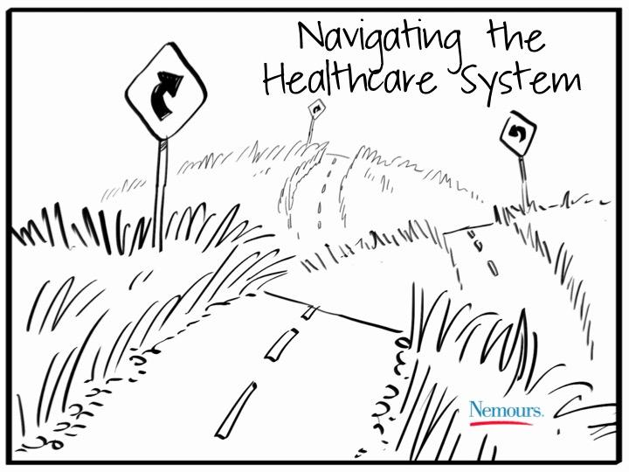
Notes:
BIG IDEA of PART ONE: Most adults struggle with navigating the health care system, getting the appropriate care, and interacting with medical staff. Having some basic knowledge and skills will make these challenges more manageable.
SAMPLE SCRIPT for PRESENTER:
“By a show of hands, how many of you can relate to that video?” (Make comments(s) to acknowledge how many people said they relate.)
“The video showed how stressful it can be with you’re trying to get care and don’t know all the rules and vocabulary. Our goal today is to provide some of the basic knowledge and skills you’ll need to manage your own health and health care, as well as the health care of your family.”

Slide 6
Words Worth Knowing
Health
Healthcare
Health Literacy
Self-Advocacy
Primary Care Physician (PCP)
Pediatrician
Internist
Family Doctor/General Practitioner
Specialist
Referral
Urgent Care
Emergency Department/Emergency Room
Family Health History
Notes:
Words Worth Knowing
BIG IDEA of THIS SLIDE: To introduce vocabulary words that will be used in this workshop. Definitions are given as we go.
“Words Worth Knowing” vocabulary list:
Health
Healthcare
Health Literacy
Self-Advocacy
Primary Care Physician (PCP)
Pediatrician
Internist
Family Doctor/General Practitioner
Specialist
Referral
Urgent Care
Emergency Department/Emergency Room
Family Health History

Slide 7
Your Interpretation
Draw, Write or Map the relationship between the following vocabulary words:
Health
Health Care
Health Literacy
Self-Advocacy
Notes:
Your Interpretation (This activity goes with pages 2-3 of the Participant Workbook for the teen version of the curriculum.)
BIG IDEA of THIS ACTIVITY: Understanding the relationship between 4 key vocabulary words: health, health care, health literacy, and self-advocacy
Step-By-Step Directions
Organize people into small groups (2-3 people per group).
Pass out pens/pencils/markers and paper to each group.
Instruct groups to create a “Concept Map” by creating a drawing that shows their understanding of the relationship between the four vocabulary words (health, health care, health literacy, and self advocacy).
SAMPLE SCRIPT for PRESENTER:
“There are four related vocabulary words that will come up multiple times throughout the presentation: health, health care, health literacy, and self advocacy. Working as a group, take about 5 minutes to create a “Concept Map”- a drawing that shows how you think these words are related. There are no wrong answers.”

Slide 8
Your Interpretation
Develop one statement that describes the group’s understanding of the relationship between the four vocabulary words:
Health
Health Care
Health Literacy
Self-Advocacy
Notes:
Your Interpretation
Step-By-Step Directions
Have each group show its Concept Map to the others and describe it.
After each group has presented, prompt the participants to identify the common ideas that came up, as well as any differences.

Slide 9
Self-Advocacy
A good self advocate is able to tell others what they think, feel and need.
                Ask questions and ask providers to repeat themselves
                Tell the medical professionals what they need to know
                Don’t assume that because they are a doctor or medical professional they know what is going on with you
Notes:
Self-Advocacy Introduction (This discussion goes with pages 2-3 of the Participant Workbook for the teen version of the curriculum.)
BIG IDEAS of THIS ACTIVITY: Understanding what self-advocacy is and the qualities of a good self-advocate; How to be a better self-advocate
SAMPLE SCRIPT for PRESENTER:
“Self-advocacy will be a running theme throughout this session. When you hear the word self-advocacy what comes to mind?” (Take ideas.)
“Self-advocacy is about being able to tell others what you think, feel, and need. When it comes to medical appointments, from dealing with the front desk to your care providers, this means a few things. It means feeling free to ask questions. Ask as many questions as you need to, until you understand everything other person is saying. (Taking notes in your phone or on paper is a great idea.) Self-advocacy also means telling the medical professionals what they need to know- from the front desk to the nurse, doctor, or other care provider. Give them as much detailed information as possible. Don’t assume that they reviewed your chart from prior visits or that they understand what’s going on with you.”
“Without giving names or sharing anyone’s personal medical information, can anyone share an example of when someone did a great job of using self-advocacy skills? Or an example of a time someone left a medical appointment kicking themselves for not being a better self-advocate?” (Take examples and discuss. Presenters may need to share an example to get the group going.)

Slide 10
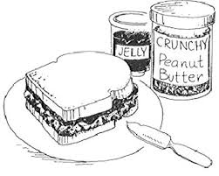
Self-Advocacy: Making a PB&J
Does everyone make their PB&J the same way?
How would someone else know EXACTLY how to make your PB&J?
How does this relate to self-advocacy and health care?
Notes:
Self-Advocacy: Making a PB&J Sandwich
**THIS IS AN ANIMATED SLIDE**
BIG IDEAS of THIS ACTIVITY: The importance of clear, detailed communication as part of self-advocacy
SAMPLE SCRIPT for PRESENTER:
While you’re on the First Animation of the slide-
“Now we’re going to do an activity that focuses on the importance of clear, detailed communication as part of self-advocacy. Working with a partner, each person should give the other instructions for xactly how to make you a perfect PB&J sandwich. Let’s try to stick to 2 minutes per person.” (After a few mintes have passed, continue.)
What did we learn from this- Did you get enough detail from your partner’s description to feel confident about making them their PERFECT sandwich? (Take a few answers. The idea is to highlight the importance of giving clear, detailed information. And to ask for more detail when you need it.)
What else did we learn- Does everyone make their PB&J exactly the same way, with exactly the same ingredients? (Take a few answers. The idea is to highlight differences from person to person.)
Advance to the Second Animation of the slide and continute-
“How does this relate to self-advocacy and health care?” (Take a few answers. Main idea #1 is that no two patients are exactly the same, even if they have the same illness or health care issue. Main idea #2 is that to get the health care you want and need, communication needs to be clear and detailed– from you to the care provider, and from the care provider to you.)
“Just like everyone has a particular way of making a PB&J sandwich, everyone has their own specific health needs. Care providers aren’t mind readers so they are not going to know what you need unless you advocate for yourself. Don’t assume they can tell how you are feeling just by looking at you. And don’t hesitate to ask questions and take notes.”

Slide 11
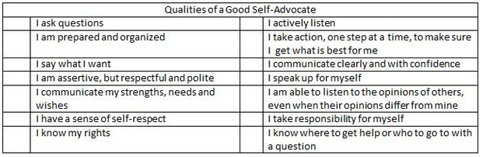
Self-Advocate Qualities
What tips will you use to strengthen your self-advocacy skills?
Which qualities do I already have?
Which qualities do I want to work on?
Tips for self advocacy:⁷
Know and understand your rights and responsibilities.
Learn all you can about your needs, strengths, and weaknesses.
Know what accommodations you may need as well as why you need them.
Know how to effectively and assertively communicate your needs and preferences.
Find out who key people are and how to contact them if necessary.
Be willing to ask questions when something is unclear or you need clarification.
Notes:
Self-Advocate Qualities (This discussion goes with page 3 of the Participant Workbook for the teen version of the curriculum.)
**THIS IS AN ANIMATED SLIDE**
BIG IDEAS of THIS ACTIVITY: The elements of being a strong self-advocate
SAMPLE SCRIPT for PRESENTER:
While you’re on the First Animation of the slide-
“This slide lists the characteristics of strong self-advocates.” (Read them out loud. Do not assume the participants can read them.)
“Which of these skills are you already good at?” (Take a few volunteers. Be prepared to share your own answers.)
“Which of these skills do you want to work on?” (Take a few volunteers. Be prepared to share your own answers.)
While you’re on the Second Animation of the slide-
“The slide lists a few tips for strengthening your self-advocacy skills.” (Read them out loud. Do not assume the participants can read them.)
“Do any of these tips jump out at you as being helpful in building your skills for self-advocacy?” (Take a few volunteers. Be prepared to share your own answers.)
“These skills are necessary to understand what your care providers are telling you and for you to be able to tell them what you’re feeling/experiencing. These self-advocacy qualities will make it easier for you to navigate the healthcare system and help you get the best care possible. ”

Slide 12

Primary Care Physician (PCP)
Pediatrician - Children
Family/General - Everyone
Internist - Adults
Regular health care appointments along with sick visits
Notes:
Types of Care Providers: Primary Care Physician (This discussion goes with page 4 of the Participant Workbook for the teen version of the curriculum.)
**THIS IS AN ANIMATED SLIDE**
BIG IDEAS of THIS SLIDE: The importance of having a PCP (Primary Care Physician); How to find a PCP that’s right for you.
SAMPLE SCRIPT for PRESENTER:
While you’re on the First Animation of the slide-
“Let’s talk a little bit about types of care providers. Health care is full of acronyms. One you probably hear a lot is “PCP”, which stands for Primary Care Physician. One type of Primary Care Physician is a pediatrician. Who gets care from pediatricians- what population?”
Advance to 2nd Animation to Show the Answer- “Children/young adults- although children can also go to family practice doctors. It’s not mandatory that infants and children are seen by pediatricians. Do any of you know how long (age wise) a child can keep going to a pediatrician’s office?” (Take answers. The point is that ages vary by office. It could be 18, 21 or when the child finishes college.)
“Other types of Primary Care Physicians include internists, general practitioners, and family practice doctors. Who typically gets care from an internist- what population?”
Advance to 3rd Animation to Show the Answer: adults
“What about general practitioners or family practice doctors?”
Advance to 4th Animation to Show the Answer: everyone
“Why do we even need to see a PCP in the first place?”
Advance to 5th Animation to Show the Answer: for annual physicals and other well visits, for vaccines, and for sick visits that aren’t an emergency

Slide 13

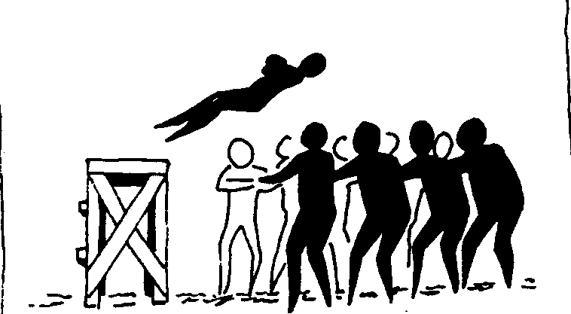
But Why?
Notice changes in health over time
Recommend & educate about healthy behaviors
TRUST!
Need to share personal (sometimes embarrassing) information
His/her medical advice
Why is it important to find the right PCP for you?
Notes:
Types of Care Providers: Primary Care Physician (This discussion goes with page 4 of the Participant Workbook for the teen version of the curriculum.)
**THIS IS AN ANIMATED SLIDE**
BIG IDEAS of THIS SLIDE: The importance of having a PCP (Primary Care Physician); How to find a PCP that’s right for you.
SAMPLE SCRIPT for PRESENTER:
While you’re on the First Animation of the slide-
“Why is it important to find the right PCP for you?”
While you’re on the Second Animation of the slide-
“Because you need to be able to trust your doctor enough to tell them personal information without feeling embarassed or judged, and so that you trust their medical advice.”
While you’re on the Third Animation of the slide-
“In addition, by seening the same provider for a long period of time, they have record of your health going back across many visits- which allows them to notice changes in your health.”

Slide 14
Specialist
What is a Specialist?
        A doctor who has special knowledge and skills relating to a particular area of medicine.
If you do need a specialist:
  Go to your doctor to discuss the issue. They will decide if you need a specialist.
  Make sure your insurance will cover the specialist’s services and treatments.
Notes:
Types of Care Providers: Specialist (This discussion goes with page 5 of the Participant Workbook for the teen version of the curriculum.)
**THIS IS AN ANIMATED SLIDE**
SAMPLE SCRIPT for PRESENTER:
While you’re on the First Animation of the slide-
“Your primary care physician is where you go for regular care. But what happens when you need care that your PCP can’t provide? There are other places you may need to go to take care of your health needs. If you need care for a more specialized health issue, you might need to see a specialist.”
While you’re on the Second Animation of the slide-
“A specialist is a medical doctor that has completed advanced education in a particular area of medicine. What are some examples of specialists? (Take a few answers. Be prepared to name a few to get the group going- dermatologist, cardiologist, oncologist, podiatrist, etc.)
While you’re on the Third Animation of the slide-
“If you think you need to see a specialist, it’s important to call your primary care physician first. This is because your PCP may be able to provide the care you need without requiring a specialist, or your PCP may be able to suggest names of specialists they trust. But mainly it’s important to check with your doctor first because some insurance plans require something called a referral (kind of like permission) from your doctor before they’ll provide payment toward your visit at the specialists. If you need a referral to see a specialist and don’t get one before your visit, you may wind up getting stuck with the whole bill.”

Slide 15



Urgent Care
Provides treatments similar to a PCP
**Outside of traditional office hours/cannot get an appointment in a timely manner
Notes:
Other Places To Get Care: (This discussion goes with page 6 of the Participant Workbook for the teen version of the curriculum.)
BIG IDEAS of THIS SLIDE: The kinds of services provided at urgent care centers; When urgent care is the best option for care
SAMPLE SCRIPT for PRESENTER:
“An urgent care center is another place you might go to take care of your health needs. Urgent care centers have become increasingly popular as a convenient option for health care. An urgent care center provides treatment for many conditions including cold or flu-like illness, cuts and lacerations, sports injuries, and eye or ear problems. Can anyone name some of the urgent care centers around here?” (Take some answers. Be prepared to share a few to get the group going- MedExpress, Minute Clinic, Walgreens/CVS clinics, Abby GoCare, etc.)
“Many people are choosing urgent care centers because they are open during times when a traditional doctor’s office is not. They’re also a convenient option for when you’re sick or injured and you can’t get a timely appointment with your PCP.”

Slide 16
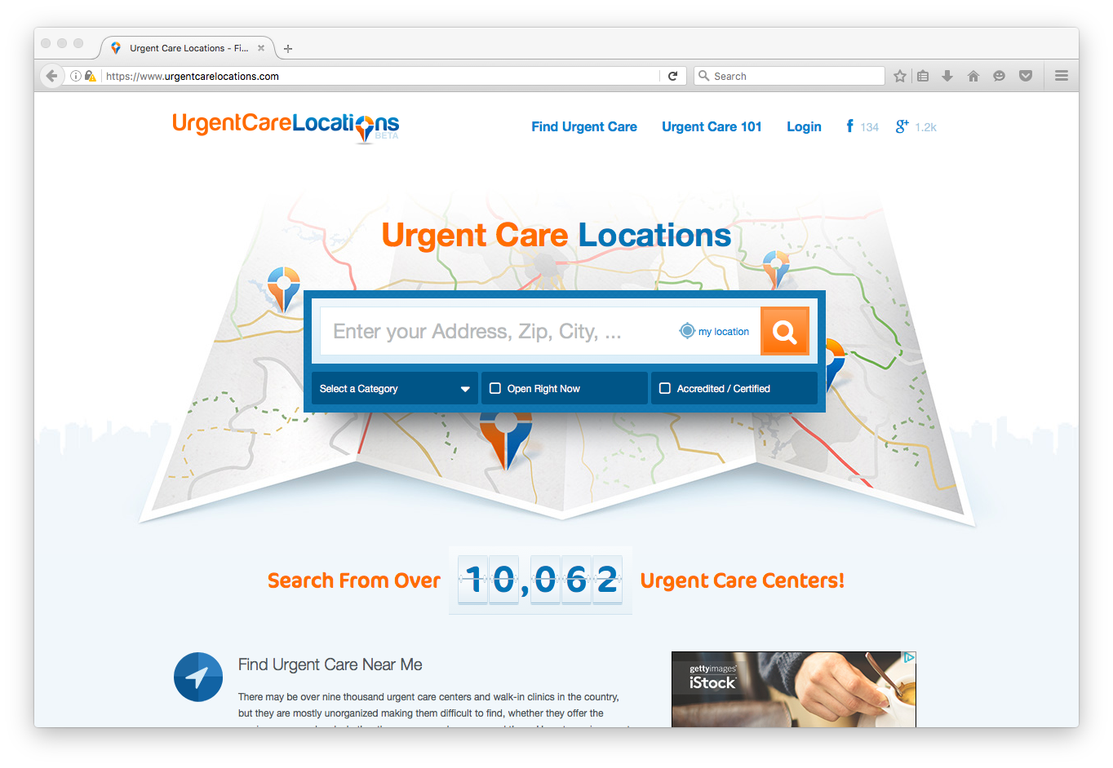

www.urgentcarelocations.com
Notes:
Other Places To Get Care: (This discussion goes with page 6 of the Participant Workbook for the teen version of the curriculum.)
**THIS IS AN ANIMATED SLIDE**
BIG IDEAS of THIS SLIDE: How to find an urgent care center
SAMPLE SCRIPT for PRESENTER:
While you’re on the First Animation of the slide-
“If you don’t know where the urgent care centers are located around here, or if you are traveling in the US and need to find an urgent care center, you can use this website (www.urgentcarelocations.com) to find care.
While you’re on the Second Animation of the slide-
You can search by Zip Code or address, or you can search “urgent care near me” in the web browser in you cell or computer.

Slide 17

Emergency Department / Emergency Room
Serious or life threatening injury or illness
**Busy, expensive, no follow up**
Notes:
Other Places To Get Care: Emergency Department / Emergency Room (This discussion goes with page 5 of the Participant Workbook for the teen version of the curriculum.)
BIG IDEAS of THIS SLIDE: When Emergency Departments are the best option for care
SAMPLE SCRIPT for PRESENTER:
“The Emergency Department (aka the Emergency Room) is open twenty-four hours a day, every day of the year. As convenient as this is, it is only meant to be used for serious or life threatening illnesses or injuries such as difficulty breathing, very high fever, severe burns, and uncontrollable bleeding. A minor ear-ache is not a problem you should be taking to an Emergency Room.
Because Emergency Departments are very busy, ED health providers can’t provide follow up care to see how you’re doing after a visit like your PCP’s office or an urgent care center would do. This is another reason why it’s better to go to an urgent care center or your PCP unless it is truly a life threatening emergency.
And finally- there’s cost to consider. Visits to the Emergency Department can cost you hundred of dollars.’

Slide 18
Getting Care in a Pandemic: KNOW BEFORE YOU GO
During the COVID-19 pandemic, care is being provided in locations and ways that change quickly. It’s important to call the provider’s office before you leave home so that you have all the latest protocols. This is true for your PCP, specialists, Emergency Departments or urgent care locations.
Notes:
(Hide or omit this slide if/when it becomes out of date….)

Slide 19

Where Should I Go?
Read assigned scenario and decide, together, where you think that person should go for care
Notes:
Where Should I Go? (This discussion goes with page 6 of the Participant Workbook for the teen version of the curriculum.)
BIG IDEAS of THIS ACTIVITY: Knowing the most appropriate place to go for care for various types of health issues
SAMPLE SCRIPT for PRESENTER:
“There are several options when it comes to getting treatment and it’s really important for you to be able to determine the most appropriate place to get care for any health issues you might face. During this activity we’ll look at different scenarios and discuss, as a group, the best place for the person to go.”
(The next 2 slides are animated. Click for each scenario, then its answer. In some cases, participants may raise “what if” considerations that somewhat disagree with the answers on the slide. The idea isn’t that there is always exactly one “right” option- the idea is to practice thinking about options and gave a general sense of what’s best.)

Slide 20
Where Should I Go?
You fall down the stairs and sprain your ankle after dinner:
      Urgent Care
      You have a high fever of 103°F and can’t stop vomiting:
      Emergency Department
You have severe ear pain on Sunday morning:
Urgent Care
Notes:
Where Should I Go? (This discussion goes with page 6 of the Participant Workbook for the teen version of the curriculum.)
**THIS IS AN ANIMATED SLIDE**
Click for each scenario, then its answer. In some cases, participants may raise “what if” considerations that somewhat disagree with the answers on the slide. The idea isn’t that there is always exactly one “right” option- the idea is to practice thinking about options and gave a general sense of what’s best.

Slide 21
Where Should I Go?
You need a physical exam (check-up) to play a sport:
      PCP/Doctor
      You have a sore throat, stuffy nose, and a cough:
      PCP/Doctor
You are having trouble breathing:
      Emergency Room
Notes:
Where Should I Go? (This discussion goes with page 6 of the Participant Workbook for the teen version of the curriculum.)
**THIS IS AN ANIMATED SLIDE**
Click for each scenario, then its answer. In some cases, participants may raise “what if” considerations that somewhat disagree with the answers on the slide. The idea isn’t that there is always exactly one “right” option- the idea is to practice thinking about options and gave a general sense of what’s best.

Slide 22
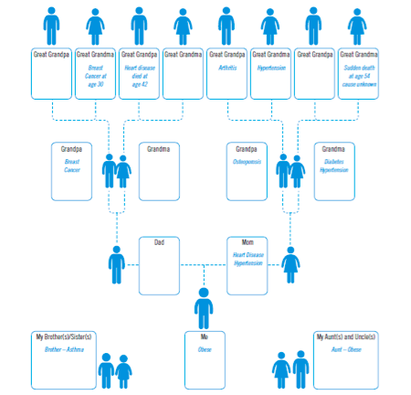
Family Health History
Notes:
Family & Personal Health History: (This discussion goes with pages 6-7 of the Participant Workbook for the teen version of the curriculum.)
BIG IDEAS of THIS ACTIVITY: Knowing how family health history can impact your health; Knowing why it’s important to share your family and personal health history with your health care providers
SAMPLE SCRIPT for PRESENTER:
“No matter where you choose to go for care, your personal and family health history are going to be important to your treatment. Just like we inherit genes from our parents that determine our hair color and personality, we inherit genes that make us more likely to have certain diseases or health issues. If two people in your family have heart disease, it does not guarantee you will have heart disease, it just means your are more likely to have heart disease.”
“Information about your personal and family health history can help the doctor identify your risks and suggest educated choices you can make to reduce those risks. Family members that are diagnosed with diseases earlier than normal, multiple family members with the same disease, and combinations of diagnoses like heart disease and hypertension can all be considered risks. Unfortunately we cannot control the genes that are passed down, but we can make choices and participate in behaviors that will reduce those risks.”
“We’re going to look at an example for Sam- on this slide.”
“What do we see, overall?” (Take responses.)
“What health risks exist for Sam” (Great Grandma & Grandpa had breast cancer - Great Grandma had it early- at age 30; Great Grandpa and Mom have heart disease; Great Grandma, Grandma, and Mom have hypertension; Grandma has diabetes; Sam is obese)
“Sam went to his PCP for a regular checkup. What do you think the doctor would suggest to him to reduce health risks based on his family and personal health history?” (Make lifestyle changes like eat healthy and exercise to reduce weight - in turn will reduce risks associated with obesity such as diabetes, heart disease, and hypertension; get checked for breast cancer because great grandma had it young and grandpa had it.)

Slide 23
Part 2:
Understanding Your Medical History

Slide 24

Words Worth Knowing
Symptoms
Diagnosis
Prescription Drug
Over-the-Counter Drug (OTC)
Drug Facts Label
Vaccine
Notes:
Words Worth Knowing
BIG IDEA of THIS SLIDE: To introduce vocabulary words that will be used in Part 2. Definitions are given as we go.
“Words Worth Knowing” vocabulary list:
Symptoms
Diagnosis
Prescription Drug
Over-the-Counter Drug (OTC)
Drug Facts Label
Vaccine

Slide 25
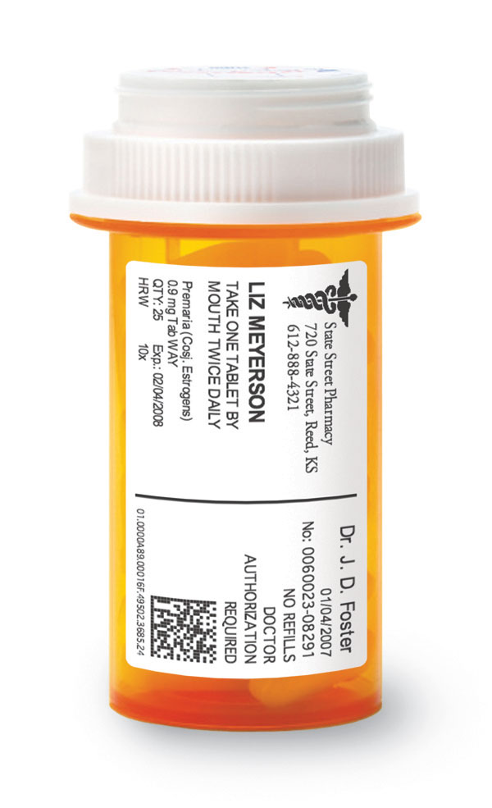
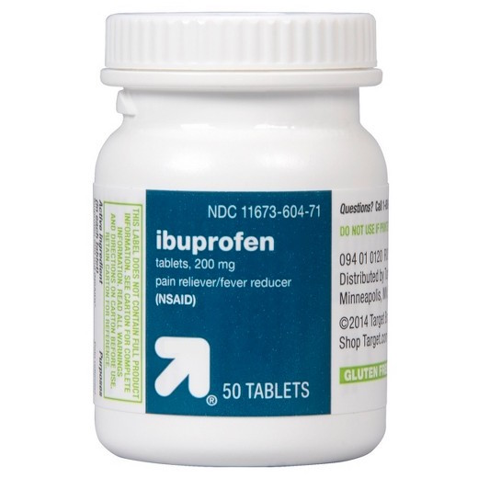
Responsible Medication Use
Understand what you are taking and what it treats
Prescription and OTC drug labels contain important information
Kahoot Quiz: https://create.kahoot.it/share/cdc73c98-d435-4351-9a6b-9c0c240b9279
Notes:
Responsible Medication Use: (This discussion goes with pages 16 of the Participant Workbook for the teen version of the curriculum.)
BIG IDEAS of THIS SLIDE: Knowing how to take prescription and over-the-counter (OTC) drugs responsibly
SAMPLE SCRIPT for PRESENTER:
“As part of your treatment, your doctor might give you a prescription for a medicine or suggest an over the counter medicine to help your medical condition. Even though a doctor recommends them, these medicines can be dangerous if they are not used responsibly. Medicines come in many different forms such as pills, liquids, and even inhalers and all of them come with information related to their use. You need to know what medication you are taking and what the medication treats so you can use them responsibly.”
“What’s the difference between prescription drugs and over the counter (OTC) drugs?” (Take answers from the group. Clarify and reinforce as needed-- Prescription drugs require a prescription from your doctor, and you have to pick them up from the pharmacy counter. Over the counter drugs are the ones you can get in a store without a prescription- like Tylenol for a headache or Claritin for allergies. Continue-)
“Just like prescription drugs, OTC drugs are an effective treatment for many health issues but need to be used carefully and correctly. For both types of medicine, reading the labels and understanding the information on the label is important so you can avoid unexpected side effects.”
OPTIONAL ACTIVITY- If technology permits, you can use the link on this slide to access the Kahoot website as a guest and take a 12 item multiple choice quiz with participants. “Understanding how to use prescription and OTC drugs safely and responsibly is an essential life skill that you’ll need in order to manage your own health and health care. Let’s move into an activity to learn more.”

Slide 26
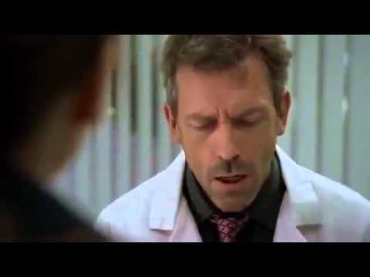
Notes:
Responsible Medication Use: (This discussion goes with pages 16 of the Participant Workbook for the teen version of the curriculum.)
BIG IDEAS of THIS SLIDE: Knowing how to take prescription and over-the-counter (OTC) drugs responsibly
SAMPLE SCRIPT for PRESENTER:
“Labels provide important information about medication. We must be able to understand the information on the label to protect ourselves. We’re going to watch a short clip from the show “House” about using an inhaler. How does an inhaler work?” (Answer: Exhale. Put the mouthpiece in your mouth and close your lips around it. Spray the medication and inhale deeply.)
“In this episode, Dr. House is trying to help Anna figure out why she is having trouble with the inhaler she uses for her asthma. Let’s watch.”
IMPORTANT NOTE: The video is embedded in this slide. IT WILL ONLY PLAY IF YOU’RE CONNECTED TO THE INTERNET WHILE YOU’RE PRESENTING.
If you’re not 100% sure you’ll have internet connection, download the video and save it to the laptop you’ll use for presenting so that you can play it from the file saved to your laptop instead of using the one embedded in this slide.
An active link to download the video is in the Preparing to Present slide, or you can copy and paste this link into your web browser: https://youtu.be/bDHEEV0M62Y

Slide 27
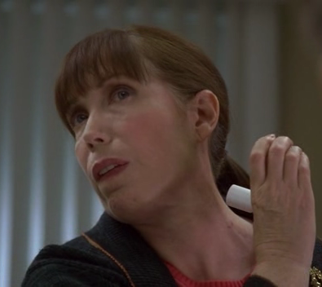
Responsible Medication Use
Important to read & understand what is printed on the label
Notes:
Responsible Medication Use: (This discussion goes with pages 16 of the Participant Workbook for the teen version of the curriculum.)
BIG IDEAS of THIS SLIDE: Knowing how to take prescription and over-the-counter (OTC) drugs responsibly
SAMPLE SCRIPT for PRESENTER:
“What happened to Anna in this clip?” (Answer: She was going through inhalers really quickly because she wasn’t using them properly.)
“How could she have avoided this embarrassing situation?” (Answer: Read the directions on the label, ask the pharmacist or doctor for help.)
“In this situation, Anna was having trouble with her inhaler she used for asthma because she wasn’t using it correctly. She was spending a lot of money to replace them once a week, and her lack of concern about what was on the label could have lead to more serious consequences.”

Slide 28
Reading OTC Drug Labels
Next, we’re going to use a sample OTC drug facts label to answer questions.
Notes:
Responsible Medication Use: (This discussion goes with pages 16 of the Participant Workbook for the teen version of the curriculum.)
BIG IDEAS of THIS SLIDE: Knowing how to take prescription and over-the-counter (OTC) drugs responsibly
SAMPLE SCRIPT for PRESENTER:
“We’re going to spend more time specifically talking about the parts of an over the counter drug label. You’ll typically find more information on these labels because they don’t require a doctor’s visit or prescription to purchase. The label essentially has to play the part of the doctor which makes it even more critical you understand what you’re reading and where to find important information. We’re going to look at a sample OTC drug label and a few different scenarios where people need to make informed decisions related to using the drug.”
“In addition to all of the information on the label, it is important to note medications have an expiration date that will be printed on the bottle or box. We need to pay attention to these expiration dates and avoid using expired medications. We have to be our own advocate when we are using OTC drugs and use our health literacy skills to use medication safely.”
“Let’s move on to the activity. I’m going to ask you questions and we’ll work together to come up with answers based on the sample label on the next slide.”

Slide 29
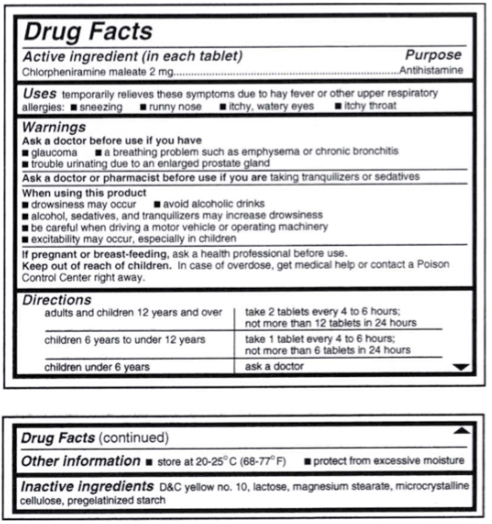
Notes:
Responsible Medication Use: (This discussion goes with pages 16 of the Participant Workbook for the teen version of the curriculum.)
Questions, with answers:
What do you use this drug for? Sneezing , runny nose, itchy, watery eyes, itchy throat
Should you take this drug if you have a headache? No
How much should you take? 2 tablets every 4-6 hours
If after 2 hours you are not feeling better should you take more? Why or why not? No, because it says every 4-6 hours
You are babysitting a 7 year old and mom told you to give them this medicine, how much do you give them? 1 tablet every 4-6 hours
You are babysitting a 2 year old, what should you do? Call their parents
What are the potential side effects? Drowsiness, excitability may occur, especially in children
What should you avoid while taking this? Alcohol, sedatives, tranquilizers, be careful when driving a vehicle or operating machinery
Because you took this does it mean you can’t drive? It depends. If this is the 1st time you’re taking it you want to see how your body reacts to it. If you’ve taken it before and it doesn’t make you drowsy it should be alright to drive.
What temperature should you store this at? 68-77◦F (room temperature)
Is storing this in your car a good idea? No

Slide 30
Part 3:
Insurance and Privacy
Notes:
IMPORTANT NOTE: Slides #33 and #34 contain state-specific information. You will need to update the slides with the information specific to your state. This should be easy to find with a quick Google search. If you need assistance, please email NTHCS@nemours.org.

Slide 31
Words Worth Knowing
Private Insurance
Government Insurance
Medicare
Medicaid
Open Enrollment
Life-Changing Event
Insurance Exchange
Prescription Insurance
Brand Name
Generic Name
Insurance Premium
Coinsurance
Member ID
Group Number
Copay
Rx (Prescription Abbreviation)
Confidentiality
Explanation of Benefits
Deductible
Co-pay
Notes:
Words Worth Knowing
BIG IDEA of THIS SLIDE: To introduce vocabulary words that will be used in Part 3. Definitions are given as we go.
“Words Worth Knowing” vocabulary list:
Private Insurance
Insurance Exchange
Medicaid
Open Enrollment
Prescription Insurance
Brand Name
Generic Name
Life-Changing Event
Premium
Deductible
Co-pay
Coinsurance
Prescription
Member ID
Group Number
Copay
Rx (Prescription Abbreviation)
Confidentiality
Explanation of Benefits

Slide 32
Health Insurance
There are two types of health insurance:
  Private
  Government:
    ~ Medicaid
    ~ Medicare
Notes:
Health Insurance: (This discussion goes with pages 22-23 of the Participant Workbook for the teen version of the curriculum.)
BIG IDEAS of THIS SLIDE: Understanding types of health insurance
SAMPLE SCRIPT for PRESENTER:
“If you broke your arm and had to go to the Emergency Room, it would cost a lot of money for you to see the doctor, get X-Rays, and get casted. Without insurance, this ER trip could cost around $5,000. WITH insurance the cost could be lowered to around $600 – a savings of $4,400!
It’s important to note that not all insurances are the same and a procedure covered by one insurance plan might not be covered by another. This is why it’s important to know what your insurance plan covers and doesn’t.
There are a few types of insurance. The type you have depends on where you get it.
The 1st type is Private Insurance. If you get insurance from your job, it’s known as private insurance. What are the names of some private insurance companies? (Take a few answers. Be prepared to give a few examples to get the group started- Aetna, Blue Cross Blue Shield, and Highmark.)
Most insurance plans allow you to be on your parents’/caregivers’ policy until you turn 26.
The 2nd type is Government Insurance. Depending on age and income you may qualify for Medicaid or Medicare. There is no cost to apply and depending on income and family size, you may qualify for free or low-cost health care.
Medicaid provides health coverage to millions of Americans, including eligible low-income adults, children, pregnant women, elderly adults and people with disabilities. Medicaid is administered by states, according to federal requirements. The program is funded jointly by states and the federal government.
Medicare is the federal health insurance program for people who are 65 or older, certain younger people with disabilities, and people with End-Stage Renal Disease (permanent kidney failure requiring dialysis or a transplant, sometimes called ESRD).
When you enroll in an insurance plan, either private or through the government, it’s only for one year. Each year, during a time called open enrollment, you can find out if there were any changes made to your plan by the insurance company such as cost or what your plan does or does not cover. During this period, you can also change the plan you pay for. It is important to know when the open enrollment period is for your insurance because it is different for every insurance plan.
If you don’t like your insurance coverage and you want to change it you have to wait for the open enrollment period. However, if you have a life-changing event (for example- a change of employment, marriage, or divorce) in the middle of the policy year, you can change your insurance if necessary.”

Slide 33
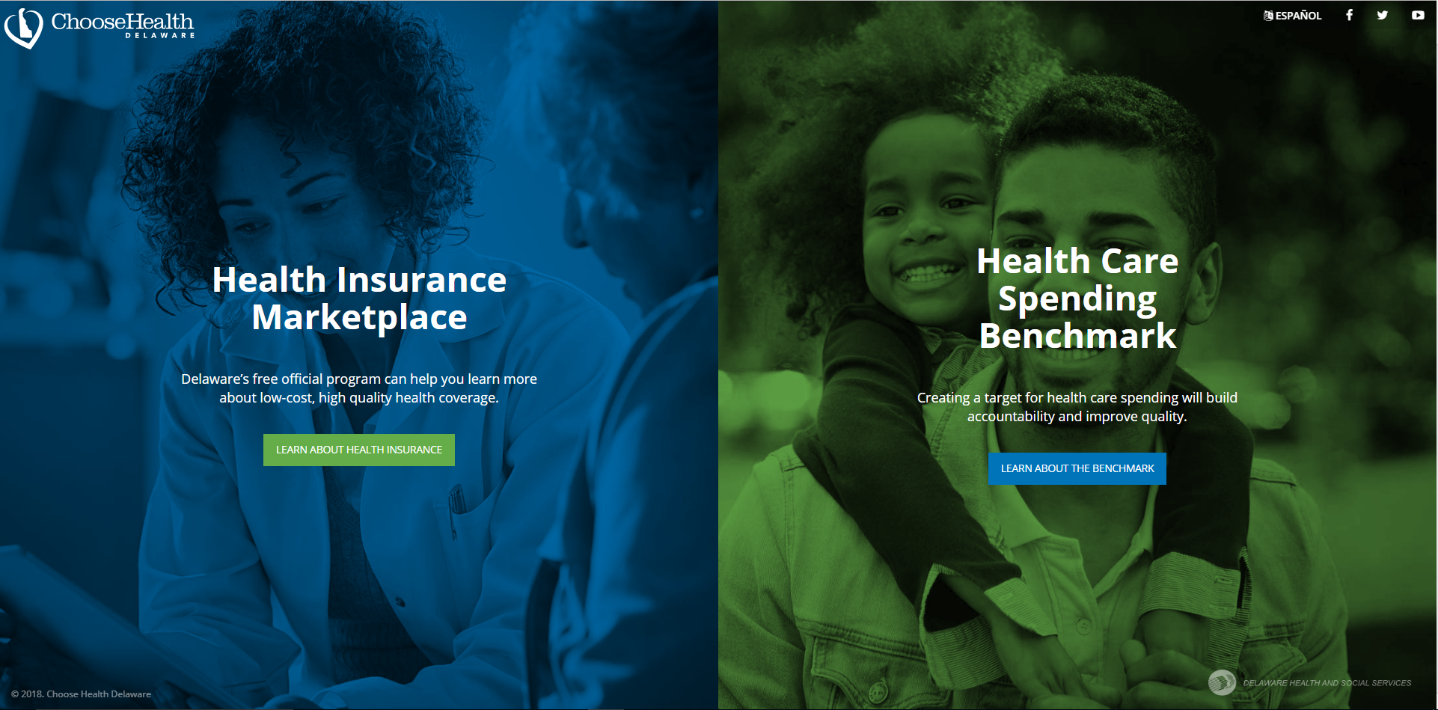
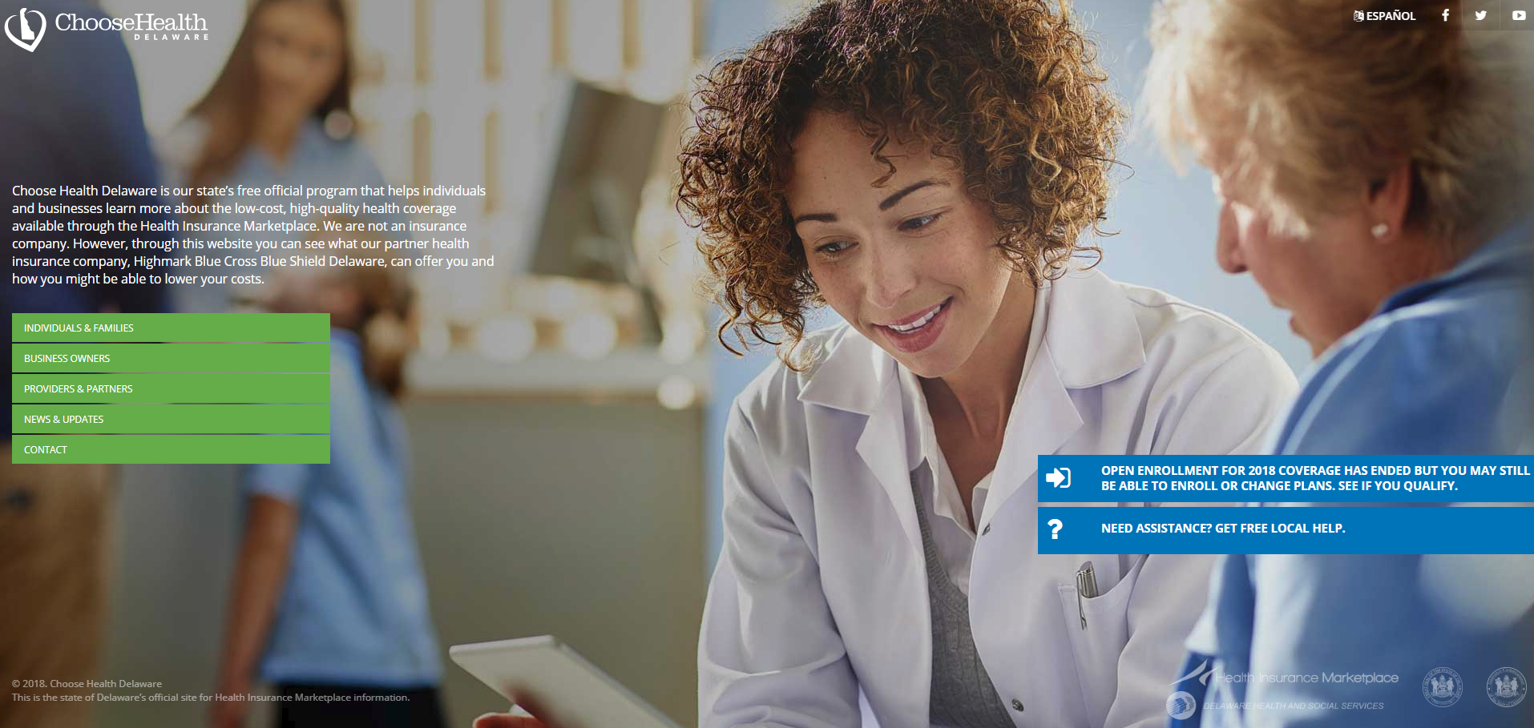
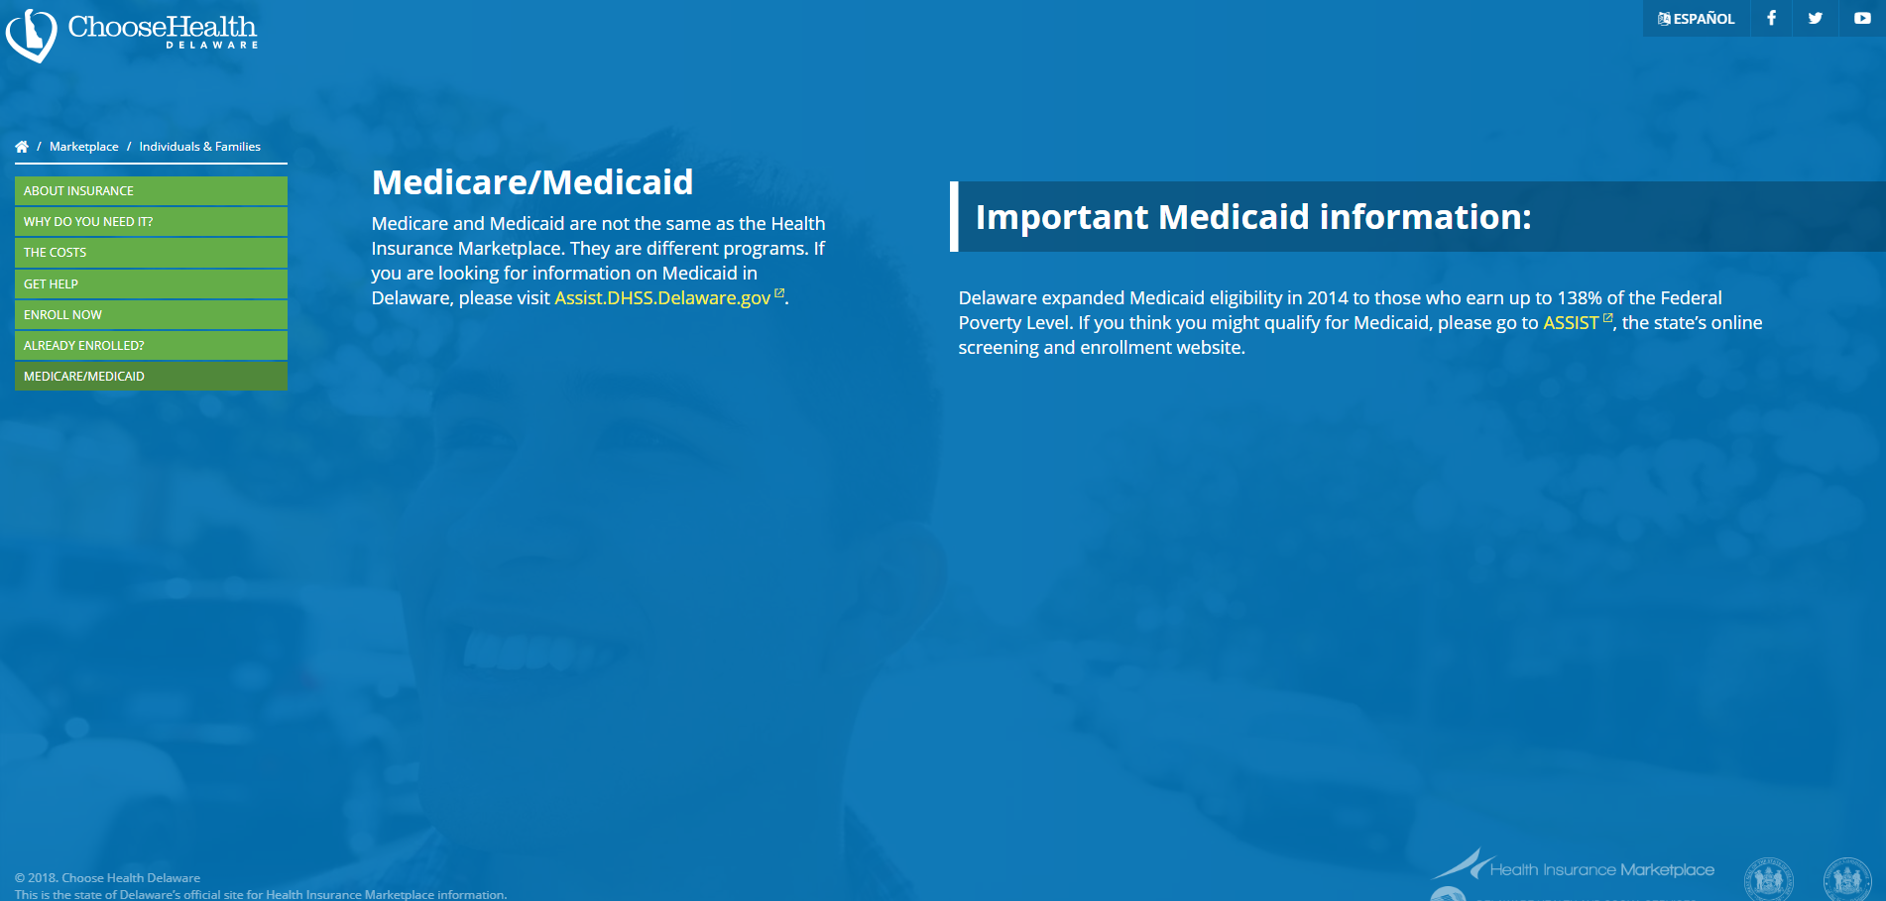
Insurance Exchange
  www.choosehealthde.com
Notes:
IMPORTANT NOTE: Slides #33 and #34 contain state-specific information. You will need to update the slides and the speaker’s note with the information specific to your state. This should be easy to find with a quick Google search. If you need assistance, please email NTHCS@nemours.org.
Health Insurance: (This discussion goes with pages 22-23 of the Participant Workbook for the teen version of the curriculum.)
**THIS IS AN ANIMATED SLIDE**
BIG IDEAS of THIS SLIDE: Understanding how to apply for insurance
SAMPLE SCRIPT for PRESENTER:
“If you don’t get insurance through an employer and you don’t qualify for government insurance then you can purchase it through the Insurance Exchange website. The Insurance Exchange is a tool for consumers to help them identify their insurance needs and purchase private insurance through the company of their choice. In order to start the application process, you must go to the website menu and click “Enroll Now”. You will need to enter basic information such as birthdates and social security numbers of those applying, information about any current health coverage and family income, and it will even give you the option to list your current doctors. After entering this information, the Insurance Exchange will show the options available to you by price, coverage, and whether or not it is accepted by your current doctors. If you are eligible for Medicaid, the results from the DE Insurance Exchange website will include a link to the Assist website where you can apply.
Unfortunately, you cannot just apply for insurance through the Exchange at any time during the year. You must wait for the open enrollment period to sign up or make any changes to the plan you currently have, unless you qualify for a special enrollment period due to a life-changing event.”
NOTE: If participants have more questions about applying for insurance outside of open enrollment, or are curious about all of the life events that would qualify for a special enrollment period, you can refer them to the following site: https://www.healthcare.gov/screener/marketplace.html

Slide 34

Types of Insurance
ASSIST Website
https://assist.dhss.delaware.gov
1 (800) 372-2022
Notes:
IMPORTANT NOTE: Slides #33 and #34 contain state-specific information. You will need to update the slides and speaker’s notes with the information specific to your state. This should be easy to find with a quick Google search. If you need assistance, please email NTHCS@nemours.org.
Types of Health Insurance: (This discussion goes with pages 22-23 of the Participant Workbook for the teen version of the curriculum.)
**THIS IS AN ANIMATED SLIDE**
BIG IDEAS of THIS SLIDE: The different types of insurance; How to apply for government insurance
SAMPLE SCRIPT for PRESENTER:
While you’re on the First Animation of the slide-
“In order to see if you qualify for Medicaid, you can go online to the ASSIST website or call the Medicaid Customer Relations number and they can help you through the process. The website is user friendly and easy to navigate.
While you’re on the Second Animation of the slide-
The Insurance Exchange (the previous slide) will also determine if you qualify for medicaid and redirect you to this site if you do.”

Slide 35
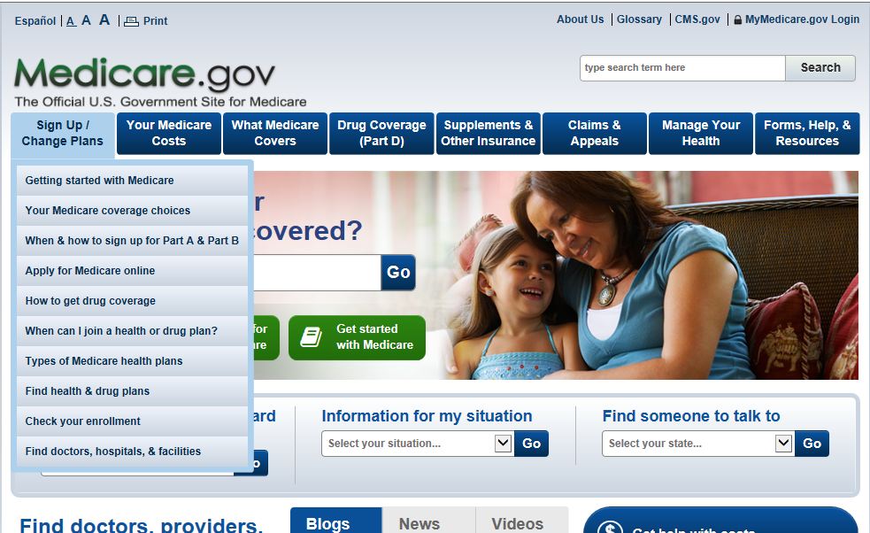
Types of Insurance- Medicare
Medicare.gov
1-800-MEDICARE (1-800-633-4227)
Notes:
Types of Insurance- Medicare: (This discussion goes with pages 22-23 of the Participant Workbook for the teen version of the curriculum.)
**THIS IS AN ANIMATED SLIDE**
BIG IDEAS of THIS SLIDE: How to apply for government insurance
SAMPLE SCRIPT for PRESENTER:
“If you qualify for Medicare, you can go online to the Medicare website or call the Medicaid Customer Relations number and they can help you through the process. The website is user friendly and easy to navigate.”

Slide 36
Prescription Insurance
Pays for medication
Included with some insurance plans
Covers brand name & generic medications
Notes:
Prescription Insurance: (This discussion goes with pages 24 of the Participant Workbook for the teen version of the curriculum.)
BIG IDEAS of THIS SLIDE: What prescription insurance is
SAMPLE SCRIPT for PRESENTER:
“An insurance plan covers your medical costs. If you broke your arm, medical insurance would help pay for care you received in the Emergency Department. HOWEVER medicine is separate. If the doctor who treated your broken arm doctor decided to prescribe pain medication, prescription insurance would help you pay for it.
Prescription insurance works similarly to medical insurance - it allows you to get medications at a much lower cost. For example, the pain medication prescribed by the Emergency Department doctor could cost $80 without insurance, but it might only be $15 if you have prescription insurance.
Prescription insurance is included in some health insurance plans, but not all. Whenever you pick a health insurance plan it’s important to find out if prescription insurance is included or if you need a separate plan for medications.
Another important part of prescription insurance is understanding the difference between brand name and generic drugs. Many times an insurance plan will include prescription coverage for both generic and brand name drugs you get from the pharmacy, though you usually have to try the generic (less expensive) drug first.. If you’ve tried the generic drug and your doctor agrees that it doesn’t work, you can usually get the insurance company to give approval for the cost of the brand name drug.”

Slide 37
Types of Health Insurance
Word Bank
-Private Insurance -Government Insurance (Medicaid) -Insurance Exchange
-Open Enrollment -Prescription Insurance
1. You can get this type of insurance through an employer
2. You may be eligible for this type of low-cost/free insurance depending on your income
3. The time period where you can change your health insurance plan
4. The website where you can identify your insurance needs and enroll in a health insurance plan.
5. You can get this type of insurance from the website in #4
6. This type of insurance helps to cover the cost of brand name and generic medication; it is included with some insurance plans
Notes:
Types of Insurance:
BIG IDEAS of THIS SLIDE: Understanding the types of health insurance
SAMPLE SCRIPT for PRESENTER:
“Let’s review the types of insurance. For each of the 6 statements on the slide, pick the word or phrase from the Word Bank that is the best fit. Words can be used more than once.”
Answer Key
1. You can get this type of insurance through an employer Private Insurance
2. You may be eligible for this type of low-cost/free insurance depending on your income Government Insurance (Medicaid)
3. The time period where you can change your health insurance plan Open Enrollment
4. The website where you can identify your insurance needs and enroll in a health insurance plan. Insurance Exchange
5. You can get this type of insurance from the Insurance Exchange: Private Insurance; Government Insurance; possibly Medicaid* (*In some states, the Insurance Exchange site will link you to the Medicaid application website if you qualify.)
6. This type of insurance helps to cover the cost of brand name and generic medication; it is included with some insurance plans Prescription Insurance

Slide 38
Insurance Basics
Word Bank
-Deductible -Co-Pay -Life-Changing Event
-Prescription -Premium -Coinsurance
The money you pay out of pocket before insurance kicks in to pay their part; if this is higher, your monthly bill is usually lower
The part (or %) of medical costs you pay once you have met your deductible
Things that allow you to change your insurance coverage even when it’s not open enrollment period- for example: getting married, having a baby, or changing jobs
The monthly bill you pay for health insurance coverage
The abbreviation for this is often “RX” on insurance cards
Fixed amount paid directly to the doctor, hospital, or other provider for medical services when you receive them
Notes:
Insurance Basics
BIG IDEAS of THIS SLIDE: Understanding the types of health insurance
SAMPLE SCRIPT for PRESENTER:
“Let’s do a little more review on the basics of insurance. For each of the 6 statements on the slide, pick the word or phrase from the Word Bank that is the best fit. This time each word in the Word Bank can only be used once.”
Answer Key
1. The money you pay out of pocket before insurance kicks in to pay their part; if this is higher, your monthly bill is usually lower Deductible
2. The part (or %) of medical costs you pay once you have met your deductible Coinsurance
3. Things that allow you to change your insurance coverage even when it’s not open enrollment period- for example: getting married, having a baby, or changing jobs Life-Changing Event
4. The monthly bill you pay for health insurance coverage Premium
5. The abbreviation for this is often “RX” on insurance cards Prescription
6. Fixed amount paid directly to the doctor, hospital, or other provider for medical services when you receive them Co-Pay

Slide 39
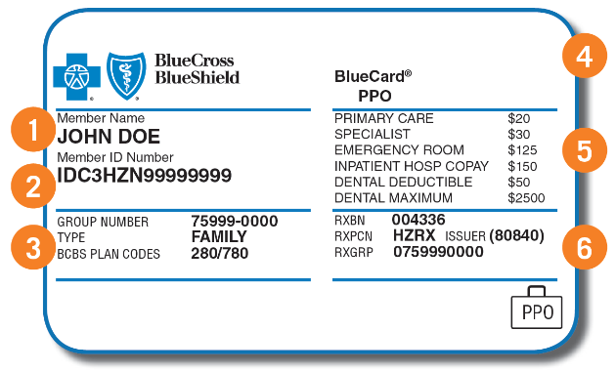
Reading Insurance Cards
Notes:
Reading Insurance Cards: (This discussion goes with pages 24-26 of the Participant Workbook for the teen version of the curriculum.)
BIG IDEAS of THIS SLIDE: Understanding the information on an insurance card
SAMPLE SCRIPT for PRESENTER:
“Once you have an insurance plan, you will receive an insurance card that acts as proof that you have insurance. Usually, when you receive any type of medical services, you will need to show your card so they can verify your plan and charge you the correct amount for the services.
Your card will include basic information about your plan. The card on this slide is only an example. Not all cards will include all of this information, but generally speaking, each card will include something similar.
If you pay for your insurance, your name (#1) will be on your card. If you are on your significant other’s insurance, you might see their name on your card - that is because they pay for it.
The member (#2) and group (#3) numbers are a way for the insurance company to know what kind of plan you have, where you get your insurance, and how you pay your bill.
You also may find the name of your plan (#4), co-pay information (#5), and prescription information marked by the symbol “Rx” (#6).”

Slide 40
Reading Insurance Cards
B
A
C
D
Notes:
Reading Insurance Cards: (This discussion goes with pages 25 of the Participant Workbook for the teen version of the curriculum.)
BIG IDEAS of THIS SLIDE: Understanding the information on an insurance card
SAMPLE SCRIPT for PRESENTER:
“Now that you know what an insurance card looks like, let’s practice identifying the various parts. Take a look at the insurance cards on this slide and try your best to answer the questions.”
Answer Key
1. Which of the cards on the screen covers prescriptions? A, B, C, D - All
2. On the Medical Assistance Card (A) what is the ID number? 0123456789
3. On the Blue Cross Blue Shield Card (B) what is the co-pay for an office visit? $20
4. On the CVS Caremark Card (D) what is the group number? CMCDX

Slide 41
Part 4:
Making/Navigating Your Visit

Slide 42
Words Worth Knowing
Self-Advocacy
Health Literacy
Notes:
Words Worth Knowing
BIG IDEA of THIS SLIDE: To introduce vocabulary words that will be used in Part 4. Definitions are given as we go.
“Words Worth Knowing” vocabulary list:
Self-Advocacy
Health Literacy

Slide 43
Completing Registration Forms
Personal and Family Health History Form
  General information – home address, height, weight, M/F, last exam
  Personal contact information – home and cell phone numbers
  Family contact information – parent/guardian? siblings?
  Emergency contact- Name and phone number
  Name, address, phone number of other doctors and specialists
  Lifestyle behaviors – do you smoke? drink?
  Illnesses or surgeries
  Current medications- names, dosages
  Allergies
  Personal and Family history – history of different illnesses in your family
  Insurance information
Notes:
Completing Registration Forms: (This discussion goes with pages 33-38 of the Participant Workbook for the teen version of the curriculum.)
**THIS IS AN ANIMATED SLIDE**
BIG IDEAS of THIS SLIDE: Registration forms can be a pain to fill out if you don’t have all the information on hand. Save the information you’ll need for registration forms in your phone or in a notebook you bring with you to appointments.
SAMPLE SCRIPT for PRESENTER:
“Nearly every time you arrive for a medical appointment and check in, they’ll hand you a clipboard and a stack of forms to fill out. These are registration forms. The most important thing to know about registration forms is that they are a HUGE pain to fill out of you don’t have the information with you. Let’s go through the list of things on a typical registration form. For each one, YES if you think you’d be able to fill in all the details from memory, or NO if you don’t think you have the information memorized.”
(Advance through each animation, making comments along the way. When you finish the list, recap the ones that participants said they wouldn’t know from memory.)
“What can you do to make it faster and easier to fill out registration forms?” (Take answers. There’s no official “right” or “wrong” answer but the idea is that they bring the information to the appointment with them to make it fast and easy to fill in the forms- either on paper or in their cell phone.)

Slide 44

The Visit
Nurse or medical assistant normally first
Use self-advocacy & health literacy skills
Notes:
The Visit: (This discussion goes with pages 40-41 of the Participant Workbook for the teen version of the curriculum.)
BIG IDEAS of THIS SLIDE:
Briefly explain the process after filling out paperwork
Stress use of skills to get the best care
SAMPLE SCRIPT for PRESENTER:
“After you’ve filled out the registration paperwork and given it back to the receptionist, a nurse or medical assistant will call your name when it’s your turn to go to an exam room. They’ll usually take your height, weight, temperature, and blood pressure. They’ll also probably ask you questions related to the reason for your visit, if you are on any medications, and if you have any other concerns.
It’s important to use your self-advocacy skills during your visit with the nurse, or medical assistant, and the doctor to make sure you are getting the right care. Remember the activity we did earlier where you had to tell the other person how to make your perfect PB&J? We talked about the importance of giving clear, detailed information. And we talked about the importance of getting clear, detailed information by asking lots of questions to make sure you understand. Let’s do some practice.”

Slide 45
The Visit:
Communicating with Detail
What brings you into the office today?
How are you feeling? What symptoms are you having?
How long have you been feeling this way?
Have you taken any medications for these symptoms? What kind and how often?
What other medications do you take? Prescription drug? Over the counter vitamins or medicine? Recreational drugs/alcohol?
Do you have any known allergies?
(For women) What was the first day of your most recent period?
Notes:
The Visit- Communicating With Detail: (This discussion goes with page 41 of the Participant Workbook for the teen version of the curriculum.)
**THIS IS AN ANIMATED SLIDE**
BIG IDEAS of THIS SLIDE: The importance of giving care providers clear, detailed information; The importance of being prepared for your appointment- be ready to give detailed answers to common questions.
SAMPLE SCRIPT for PRESENTER:
“It isn’t enough to just say, ‘Use your self advocacy skills when you go to the doctor.’ We need to know what that means and what it looks like in a healthcare setting. We’re going to go through a list of questions you’ll usually get asked at a doctor’s appointment and practice giving examples of unclear, then clear answers.”
(Advance through each animation. For each one, ask a volunteer to give an unclear answer that wouldn’t be very helpful to the care provider then ask another volunteer to give a detailed response that would be helpful. When you’re done, reinforce the two big idea of this slide.)

Slide 46

Questions?
Notes:
SAMPLE SCRIPT for PRESENTER:
“That’s it for today’s session. Are there any questions before we close?”
(Answer questions to the best of your ability. It’s ok if you don’t have answers to every question. Provide participants with the name, phone number, and email of someone they can contact with follow up questions.)

Slide 47


